Slide 1
https://www.youtube.com/watch?v=2i8ZqL99Vz0

Slide 2
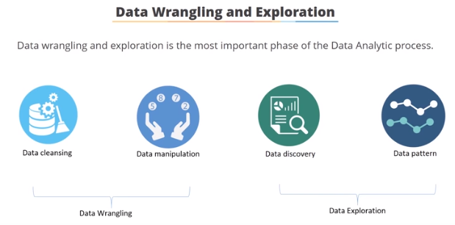
Transform
Merge
Aggregate
Groupby
Reshape
Transform the data & make it available for EDA

